Slide 1
Design and Implementation of Anti-collision Algorithms for Dense RFID Systems
A Doctoral Thesis
by
Hazem Elsaid Ibrahim
MSc of Electrical Engineering
Notes:
Good afternoon everyone.
Today I will present my doctor thesis under the title of “Title"

Slide 2

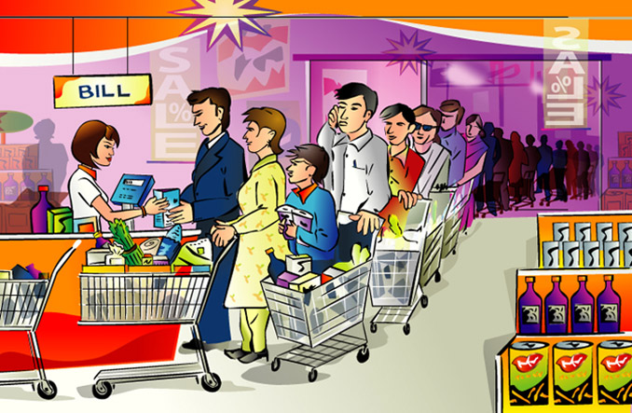

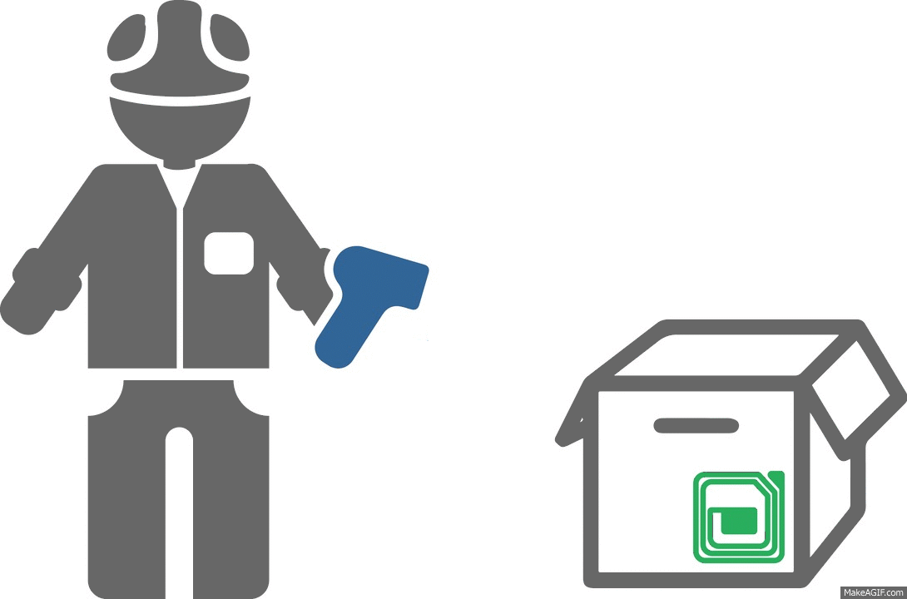

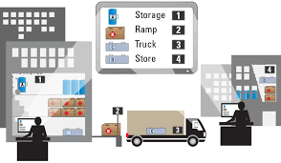


Motivation
Notes:
Most of us spend a lot of time waiting to pay for his goods. This problem demotivates us from doing shopping. Nevertheless, it encourages the researches to find a faster identification system.
On a large scale, we can imagine how tracking the status and the location of the shipped items is extremely valuable information for the logistics companies.
Moreover, in big factories, having a good tracking system is very important to minimize the time spent searching for critical equipment which might lead to expensive delays or missed deadlines.
In such applications, either the Barcode or the RFID technology is used.

Slide 3
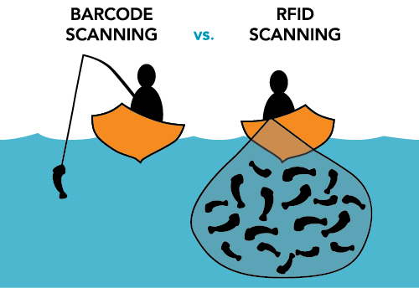

Differences Between RFID and Barcode
Limited to LOS scanning
manual intervention
Not limited to LOS scanning
Fully automated process
Only read
Significantly faster
Read/write
Limited speed
Notes:
Let's now have a look at the differences between the RFID and Barcode.
Therefore, these advantages encouraged the research groups to pay more attention to the RFID technology especially in dense applications.

Slide 4




Outline
01
RFID Reading Process
02
MAC-Layer Optimization Proposals
Tags Population Estimation
Frame Length Optimization
03
Improvements of the EPCglobal C1 G2 Standard
04
Conclusion
Notes:
The outline of this presentation includes:
A brief introduction to the conventional RFID reading process will be presented.
Afterwards, the proposed MAC layer optimization proposals will be discussed in details, for both Tag estimation and in Frame length optimization.
Then, the proposed improvements of the EPCglobal C1 G2 will be discussed in details.
Finally, conclusion for the work will be presented

Slide 5
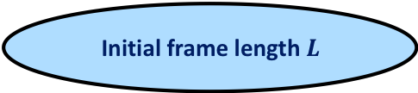

RFID Reading Process: Frame Slotted ALOHA (FSA)^{[1, 2]}
Initial frame length $L$
Tag
Reader
$$L$$
[1] F. Schoute 1983.
[2] H. Vogt 2002.
Notes:
This work focuses on systems, that have single RFID reader and dense RFID objects (tags).
The main target is to identify all the tags in the reading area in the minimum possible time.
Conventional reading process uses FSA.
FSA starts with initial frame length L
The reader broadcast the frame length to all the tags in the reading area.
Then every tag chooses random slot to be identified

Slide 6
RFID Reading Process: Frame Slotted ALOHA (FSA)^{[1, 2]}
Initial frame length $L$
Observe slots
(Successful)
Tag
Reader
S
$$L$$
[1] F. Schoute 1983.
[2] H. Vogt 2002.
Notes:
Thus, the reader receives a successful slot, when it only receives a single tag reply

Slide 7
RFID Reading Process: Frame Slotted ALOHA (FSA)^{[1, 2]}
Initial frame length $L$
Observe slots
(Successful, Empty)
Tag
Reader
S
E
$$L$$
[1] F. Schoute 1983.
[2] H. Vogt 2002.
Notes:
If no tag choose this slot, the reader will receive an empty slot

Slide 8
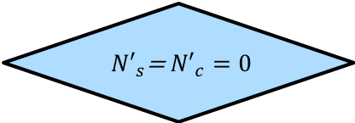
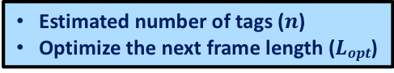
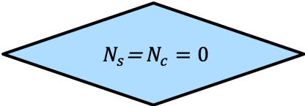
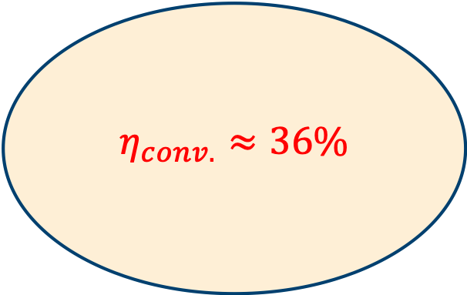
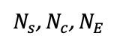
RFID Reading Process: Frame Slotted ALOHA (FSA)^{[1, 2]}
Initial frame length $L$
Observe slots
(Successful, Empty, Collided)
$$η_{conv.}≈36\%$$
$N_{s}\text{, }N_{c}$, $N_{E}$
$N_{s}\text{=} N_{c}=0$
yes
End
No
Tag
Estimated number of tags ($n$)
Optimize the next frame length ($Lopt$)
Reader
S
E
C
$$L$$
[1] F. Schoute 1983.
[2] H. Vogt 2002.
Notes:
If more than one tag choose this slot, the reader will receive a collided slot.
Afterwards, the reader counts the number of collided successful and collided slots.
if they are zero, the reader will end the process.
if not, the reader will continue doing the following two steps:
Estimate the remaining number of tags
calculate the optimum frame length for the upcomming reading cycle.
This step is the most critical step in optimizing FSA

Slide 9
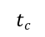
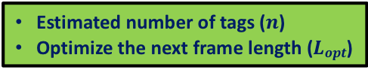

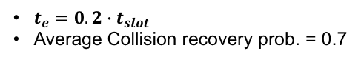
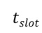
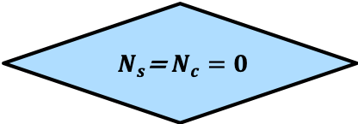
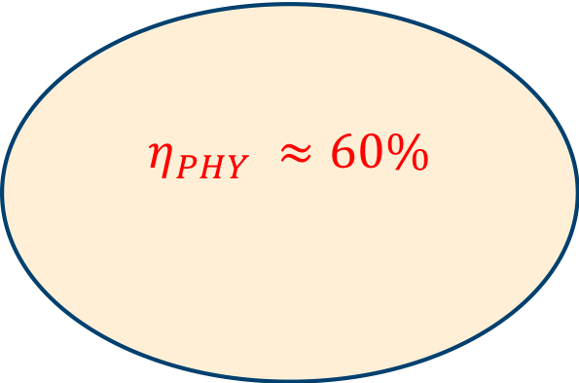
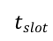
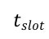
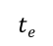
RFID Reading Process: PHY-Layer Parameters^{[1, 2]}
Initial frame length $L$
Time Aware ^{[1]}
S
C
E
C
C
S
$$tslot$$
$$tslot$$
$$tslot$$
Observe slots
(Successful, Empty, Collided)
S
C
E
C
C
S
$$η_{PHY} ≈60\%$$
$N_{s}\text{, }N_{c}$, $N_{E}$
$$tS$$
$$tc$$
$$te$$
$N_{s}\text{=} N_{c}=0$
yes
End
Collision Recovery ^{[2]}
No
$t_{e}=0.2∙t_{slot}$
Average Collision recovery prob. = 0.7
PHY-Layer
S
C
E
C
C
S
^{[1]}Time Aware
^{[2]}Collision Recovery
Estimated number of tags ($n$)
Optimize the next frame length ($Lopt$)
S
S
E
C
S
S
[1] J. Alcaraz, J. Vales-Alonso 2013.
[2] D. Donno, L. Tarricone 2012.
Notes:
Nodern RFID receivers, have an advanced physical layer.
The Reader can quickly identify the type of a slot. Then, terminates the slot as soon as it recognizes that the slot is empty or collided slot.
Hence, the duration of the different slots types are different. This called (Time Aware system).
The reader has the capability of converting part of the collided slots into successful slots. This called (collision recovery capability).
According to the state of the art, FSA efficiency reaches to 60% if the slot duration of the empty slot is 0.2 of the normal slot duration and with collision recovery probability 0.7.

Slide 10

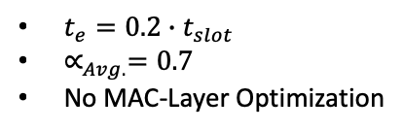
FSA with PHY-Layer Improvement
PHY-Layer
$t_{e}=0.2∙t_{slot}$
$∝_{Avg.}=0.7$
No MAC-Layer Optimization
FINALLY
Not yet!!
RFID
Optimized??
100%
RFID
RFID
36%
60%
MAC-Layer Optimization
Notes:
Although, the FSA increased by improving the physical layer, there still room for further improvement by improving the MAC-layer.

Slide 11

Outline
01
RFID Reading Process
02
MAC-Layer Optimization Proposals
Tags Population Estimation
Frame Length Optimization
03
Improvements of the EPCglobal C1 G2 standard
04
Conclusion and Future Work
Notes:
The first step of the MAC layer optimization is to improve the tags population estimation algorithm.

Slide 12


Tags Population Estimation
How many objects do I have?
$$\hat{n}=−\frac{π}{2}+\int_{−2}^{4}{a^{2}\sqrt{b^{2}−x^{2}} }$$
Notes:
Now the question is:
How Conventional FSA estimates the tags populations?

Slide 13
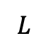

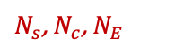
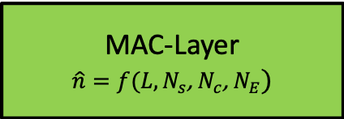
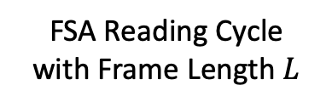
Tags Population Estimation Conventional System^{[1, 2]}
$$L$$
FSA
FSA Reading Cycle
with Frame Length $L$
$N_{s}\text{, }N_{c}$, $N_{E}$
Tags population
Estimation Function
MAC-Layer
$$\hat{n}=f(L,N_{s}\text{, }N_{c}\text{, }N_{E})$$
$$\hat{n}$$
[1] F. Schoute 1983.
[2] H. Vogt 2002.
Notes:
For every FSA reading cycle, a new frame length is defined.
The output of every reading cycle is the number of successful, collided and empty slots.
The number of tags population estimation function is function of the frame length and NS,NC, and NE

Slide 14


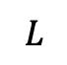
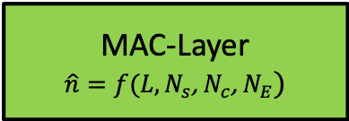

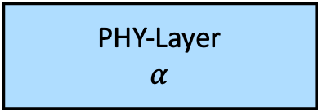
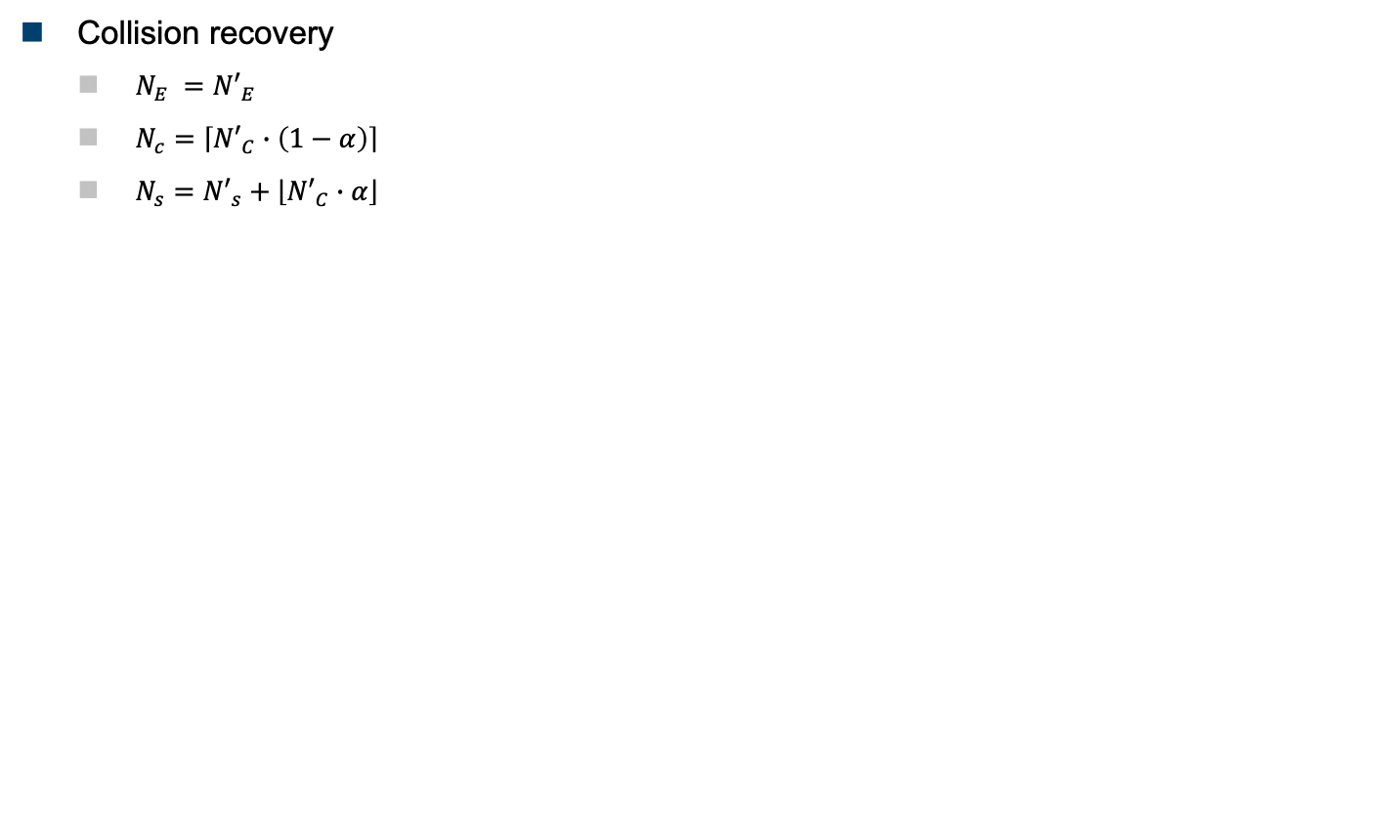

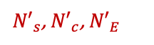
Tags Population Estimation Conventional System^{[1, 2]}
Collision recovery
$N_{E} ={N′}_{E}$
$N_{c}=\left\lceil {N′}_{C}∙\left(1−α\right)\right\rceil$
$N_{s}={N′}_{s}+\left\lfloor {N′}_{C}∙α\right\rfloor$
$$L$$
FSA
Before
Collision Recovery
${N′}_{s}\text{, }{N′}_{c}$, ${N′}_{E}$
$α$ is neglected in MAC calculations!!
PHY-Layer
$$α$$
After
Collision Recovery
$N_{s}\text{, }N_{c}$, $N_{E}$
MAC-Layer
$$\hat{n}=f(L,N_{s}\text{, }N_{c}\text{, }N_{E})$$
[1] F. Schoute 1983.
[2] H. Vogt 2002.
$$\hat{n}$$
Notes:
In the systems which have a collision recovery capabilities, the number of successful, collided and empty slots strongly depends on the collision recovery capability of the reader.
However, this information is neglected in the MAC layer calculations.

Slide 15
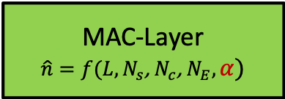
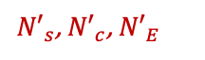
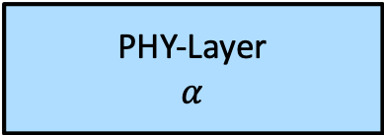


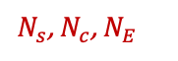
Tags Population Estimation Proposed System
Collision recovery
$N_{E} ={N′}_{E}$
$N_{c}=\left\lceil {N′}_{C}∙\left(1−α\right)\right\rceil$
$N_{s}={N′}_{s}+\left\lfloor {N′}_{C}∙α\right\rfloor$
$$L$$
FSA
Before
Collision Recovery
${N′}_{s}\text{, }{N′}_{c}$, ${N′}_{E}$
PHY-Layer
$$α$$
After
Collision Recovery
$$α$$
$N_{s}\text{, }N_{c}$, $N_{E}$
MAC-Layer
$$\hat{n}=f(L,N_{s}\text{, }N_{c}\text{, }N_{E},α)$$
$$\hat{n}$$
Notes:
In the proposed estimation function, the collision recovery capability of the system is considered.

Slide 16

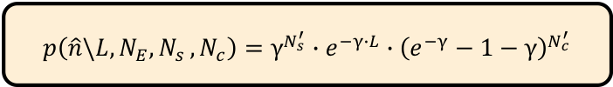
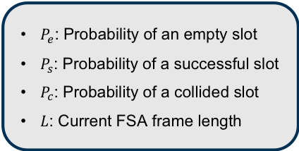
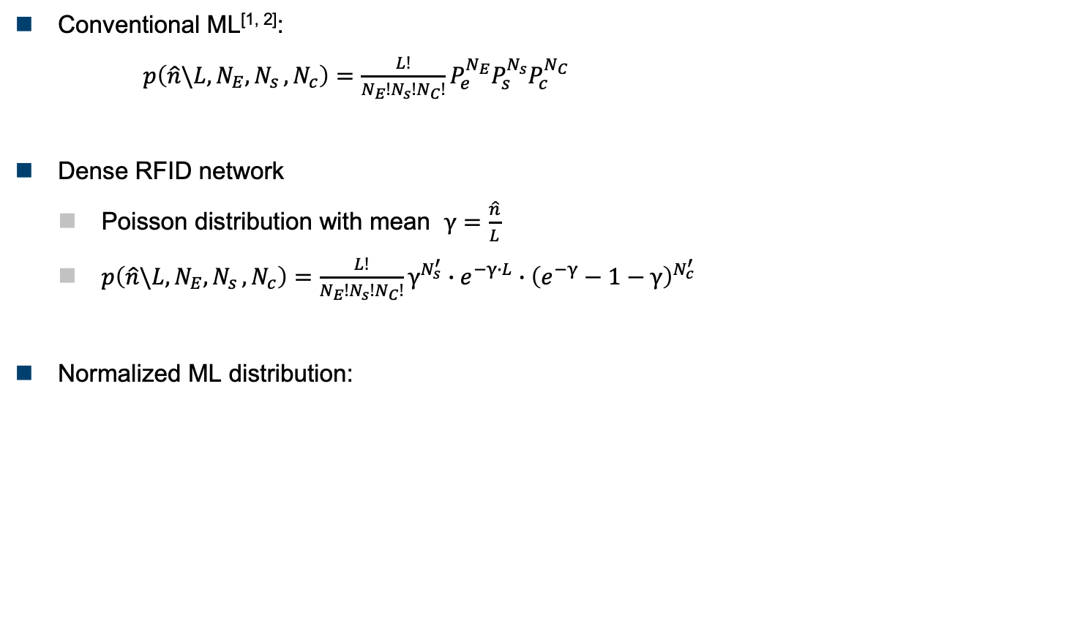
Tags Population Estimation Proposed System
Conventional ML^{[1, 2]}:
$p\left(\hat{n}\backslash {L,N}_{E}{, N}_{s},N_{c}\right)=\frac{L!}{N_{E}!N_{s}!N_{C}!}P_{e}^{N_{E}}P_{s}^{N_{s}}P_{c}^{N_{C}}$
Dense RFID network
Poisson distribution with mean $γ=\frac{\hat{n}}{L}$
$p\left(\hat{n}\backslash {L,N}_{E}{, N}_{s},N_{c}\right)=\frac{L!}{N_{E}!N_{s}!N_{C}!}γ^{N_{s}^{′}}∙e^{−γ∙L}∙{\left(e^{−γ}−1−γ\right)}^{N_{c}^{′}}$
Normalized ML distribution:
$P_{e}$: Probability of an empty slot
$P_{s}$: Probability of a successful slot
$P_{c}$: Probability of a collided slot
$L$: Current FSA frame length
$$p\left(\hat{n}\backslash {L,N}_{E}{, N}_{s},N_{c}\right)=γ^{N_{s}^{′}}∙e^{−γ∙L}∙{\left(e^{−γ}−1−γ\right)}^{N_{c}^{′}}$$
[1] W.-T. Chen Chen 2009.
[2] E. Vahedi, V. Wong, I. Blake, and R. Ward 2011.
Notes:
The above equation presents a ML number of tags estimator proposed in the state of the art.
The equation finds the optimum number of tags n that gives exact NE, Ns, Nc times in L trials.
For dense RFID network, Poisson distribution could be used
After normalization, the ML equation could be written as shown
However, the numerical searching in this eq. limits the number of tags.
Moreover, the equation still doesn't consider the collision recovery capability effect of the PHY-layer.

Slide 17
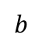
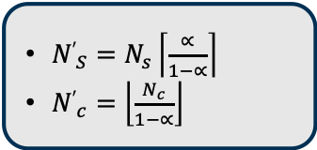
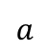
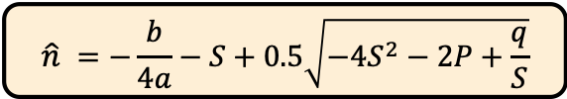
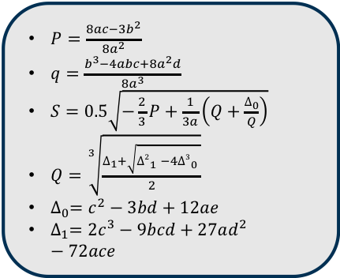
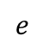
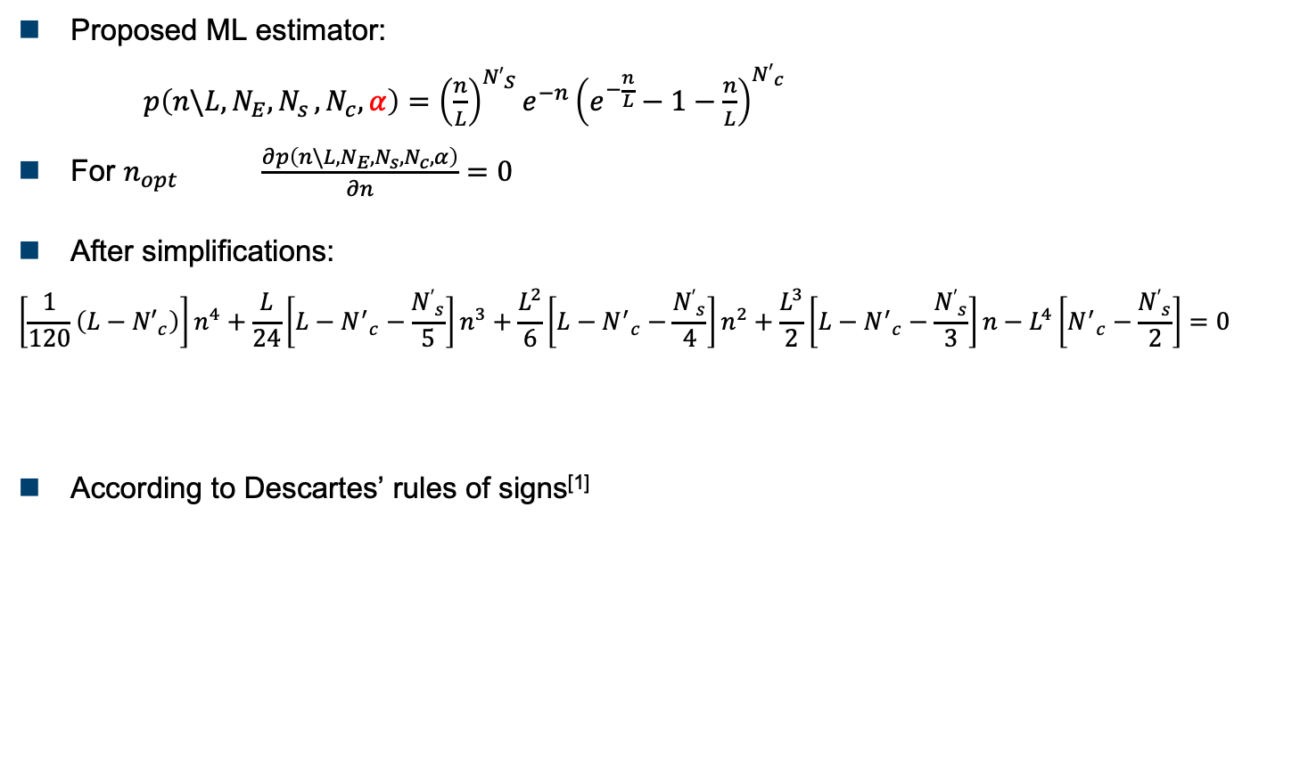
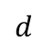
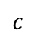
Tags Population Estimation Proposed System
Proposed ML estimator:
$p\left(n\backslash {L,N}_{E}{, N}_{s},N_{c},α\right)={\left(\frac{n}{L}\right)}^{{N′}_{S}}e^{−n}{\left(e^{−\frac{n}{L}}−1−\frac{n}{L}\right)}^{{N′}_{c}}$
For $n_{opt}$ $\frac{∂p\left(n\backslash {L,N}_{E}{, N}_{s},N_{c},α\right)}{∂n}=0$
After simplifications:
$$\left[\frac{1}{120}\left(L−{N′}_{c}\right)\right]n^{4}+\frac{L}{24}\left[L−{N^{′}}_{c}−\frac{{N′}_{s}}{5}\right]n^{3}+\frac{L^{2}}{6}\left[L−{N^{′}}_{c}−\frac{{N′}_{s}}{4}\right]n^{2}+\frac{L^{3}}{2}\left[L−{N^{′}}_{c}−\frac{{N′}_{s}}{3}\right]n−L^{4}\left[{N^{′}}_{c}−\frac{{N′}_{s}}{2}\right]=0$$
According to Descartes’ rules of signs^{[1]}
${N′}_{S}=$ $N_{s}\left\lceil \frac{∝}{1−∝}\right\rceil$
${N′}_{c}=\left\lfloor \frac{N_{c}}{1−∝}\right\rfloor$
$$a$$
$$b$$
$$c$$
$$d$$
$$e$$
$P=\frac{8ac−3b^{2}}{8a^{2}}$
$q=\frac{b^{3}−4abc+8a^{2}d}{8a^{3}}$
$S=0.5\sqrt{−\frac{2}{3}P+\frac{1}{3a}\left(Q+\frac{∆_{0}}{Q}\right)}$
$Q=\sqrt[3]{\frac{∆_{1}+\sqrt{{∆2}_{1}^{}−4{∆3}_{0}^{}}}{2}}$
$∆_{0}=c^{2}−3bd+12ae$
$∆_{1}={2c}^{3}−9bcd+27ad^{2}−72ace$
$$\hat{n} =−\frac{b}{4a}−S+0.5\sqrt{−4S^{2}−2P+\frac{q}{S}}$$
[1] D. Struik, A Source Book in Mathematics 1986
Notes:
Therefore, a new ML estimation function is presented. Which considers the collision recovery capability of the reader
To calculate the optimum number of tags from the above equation, we have to differentiate the equation with respect to n
After simplification we reached to a 4th order equations with 4 solutions.
Using Descertes’ rules of sign, We can prove that the equation has a single valid real positive solution.

Slide 18
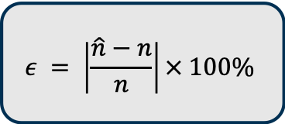
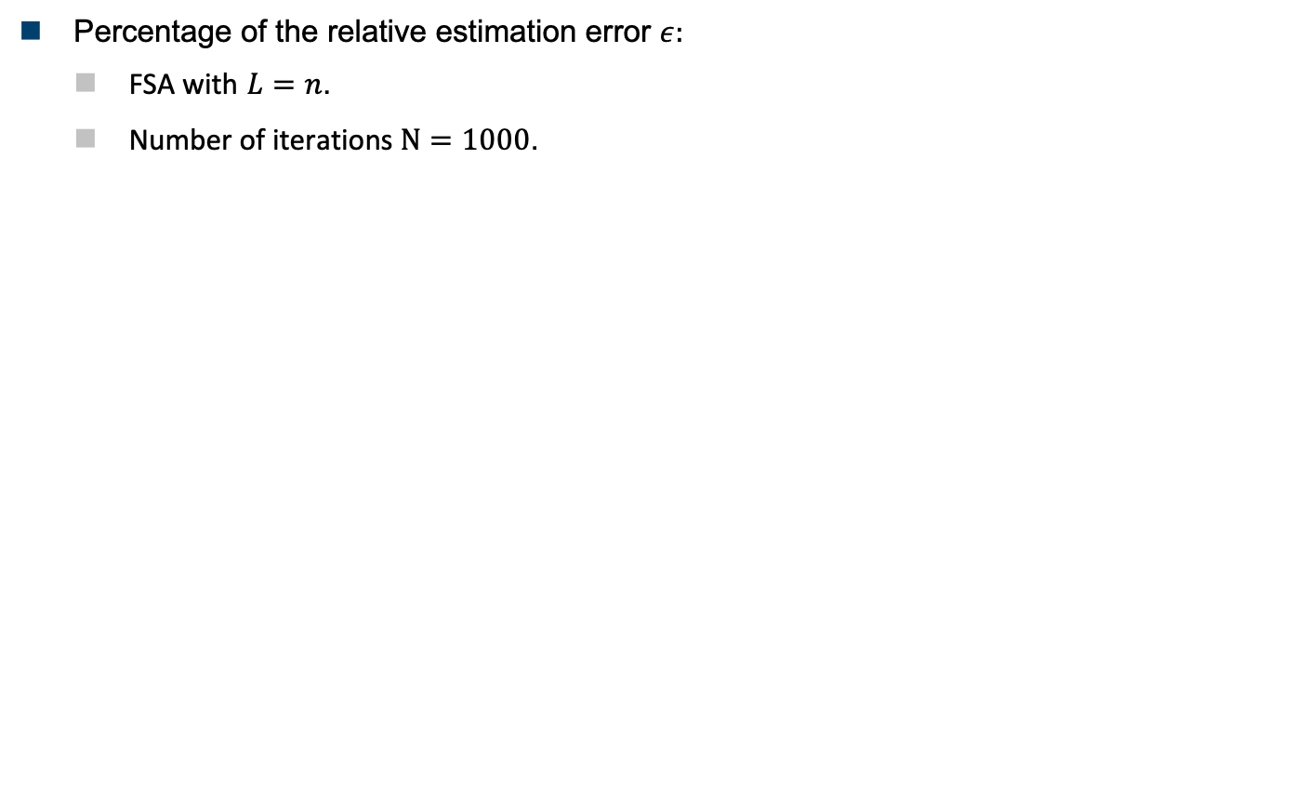
Tags Population Estimation Simulations results
Percentage of the relative estimation error $ε:$
FSA with $L=n$.
Number of iterations $Ν=1000$.
$$ε = \left|\frac{\hat{n}−n}{n}\right|× 100\%$$
Notes:
This figure shows the percentage of the relative estimation error of the proposed formula compared to the most popular estimation algorithms in the state of the art.
The figure shows the effect of the collision recovery capability on the relative estimation error.
According to the figure, the proposed formula results in the best performance compared to the other algorithms.

Slide 19

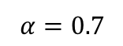
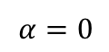
Tags Population Estimation Simulations results
Mean identification time for $n$ number of tags:
FSA with $L=n$, $α_{Avg.}=0.7$
Number of iterations $Ν=1000$.
30%
Notes:
In dense RFID applications, the total identification time is the most important performance metric.
The presented results use FSA with L=n and 0.7 average collision recovery probability
Accordingly, the proposed formula results in the best performance compared to the state of the art.
According to the simulations, there is around 30% room of improvement to reach the theoretical lower limit of FSA.

Slide 20
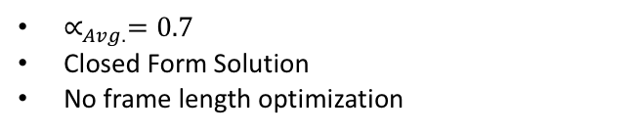
FSA after Tags Population Estimation
PHY-Layer
$t_{e}=0.2∙t_{slot}$
$∝_{Avg.}=0.7$
No MAC-Layer Optimization
Estimation
$∝_{Avg.}=0.7$
Closed Form Solution
No frame length optimization
RFID
RFID
RFID
70%
36%
60%
Notes:
Therefore, the FSA reading efficiency after tags populations estimation with average alpha 0.7 is increased by 10%.
This is without Frame length optimization

Slide 21
Outline
01
RFID Reading Process
02
MAC-Layer Optimization Proposals
Tags Population Estimation
Frame Length Optimization
03
Improvements of the EPCglobal C1 G2 standard
04
Conclusion
Notes:
The second step of the MAC layer optimization is to incorporate the physical layer parameters with the frame length optimization.

Slide 22


















Frame Length Optimization
$L=6$, $η=30\%$
S
C
E
C
C
S
Time Aware
$$Tslot$$
$$Tslot$$
$$Tslot$$
$$L$$
Time Aware & Collision Recovery
S
E
S
E
E
S
E
S
E
$L$ or
$L=9$, $η=50\%$
$L=9$, $η_{t}=50\%$
S
E
S
E
E
S
E
S
E
$$TS$$
$$Te$$
S
C
E
C
C
S
$L=6$, $η=30\%$
Collision Recovery
$$L$$
C
E
C
C
S
E
S
S
$$L=4, η=75\%$$
Notes:
Let's assume that we have a Time aware FSA. It is better to increase the frame length as the losses from the empty slots are so small.
On the other hand, if the system has collision recovery capability, so it is better to decrease the frame length as the reader can benefit from collided slots.
So what would be the optimum frame length if the system has both time aware and collision recovery capability?

Slide 23





Frame Length Optimization Conventional System^{[1-3]}
Reading efficiency:
$η_{conv.}=\frac{N_{s}}{N_{s}+N_{c}+N_{E}}=\frac{N_{s}}{L}$
For optimum frame length
$\frac{∂η_{conv.}}{∂L}=0$
Conventional FSA optimum frame length:
FSA
$N_{s}\text{, }N_{c}$, $N_{E}$
MAC Layer
$$L_{conv. }=f(n)$$
$$L_{conv.}=n$$
$$L_{conv. }$$
[1] F. Schoute 1983.
[2] H. Vogt 2002.
[3] L. Zhu and T. Yum 2010.
Notes:
According to FSA, the conventional reading efficiency is the average number of successful slots over the frame length
The optimum frame length is L=n

Slide 24





Frame Length Optimization Time Aware System
Reading efficiency:
$η_{TA}=\frac{N_{s}⋅t_{s}}{N_{s}⋅t_{s}+N_{c}⋅t_{c}+N_{E}⋅t_{e}}$
For optimum frame length
$\frac{∂η_{TA}}{∂L}=0$
After simplifications:
${\left(\frac{L_{TA}}{n}\right)}^{2}C_{t}−\left(\frac{L_{TA}}{n}\right)C_{t}+0.5\left(C_{t}−1\right)=0$,
where, $C_{t}=\frac{t_{e}}{t_{c}}$ is the slot duration constant
Proposed Time Aware Frame Length:
FSA
$N_{s}\text{, }N_{c}$, $N_{E}$
PHY Layer
$t_{e}$, $t_{c}\text{,} t_{s}$
MAC Layer
$$L_{TA}=f(t_{e}\text{,} t_{k}\text{, }n)$$
$$L_{TA}=\frac{n}{2}\left(1+\sqrt{\frac{2}{C_{t}}−1}\right)$$
$$L_{TA }$$
Notes:
In time aware system, the reading efficiency should be presented as a timing reading efficiency.
To calculate the optimum frame length, we have to differentiate the reading efficiency with respect to L. and equate the result to zero
After simplification we reached this closed form solution.

Slide 25

Frame Length Optimization: Time Aware System
Frame length comparison
Number of tags $n=100$
$C_{t}$: Slot duration constant
Notes:
These graphs show the optimum Time aware frame length using the numerical solution compared to the proposed formula in the complete range of the slot duration constant.
In the simulations, a fixed number of tags are used, which are 100 tags.
According to the graph, the proposed formula approaches the numerical results with a small bias coming from the Taylor series approximation during the proof.
According to the RFID standards, the frame length can take only quantized values (power of 2), which remove the effect of the taylor approximation.

Slide 26


Frame Length Optimization: Time Aware System
Percentages of the mean reading time reduction
FSA using $L_{TA}$ compared to $L_{conv.}$
1000 iterations
$C_{t}=0.2$
$$ζ= \left(\frac{T_{conv}−T_{pro}}{T_{conv}}\right)× 100\%$$
Notes:
To emphasize the gain of the proposed system, the mean reading time reduction using the proposed time aware frame length compared to the conventional FSA frame length is presented
In case of perfect estimation, the Time aware system gives 5% reading time reduction compared to the conventional systems.
According to the graph, the better estimation algorithm, the less reading time reduction, because it decreases the number of iterations in FSA process.

Slide 27






Frame Length Optimization: Time and Collision Recovery Aware System
Reading efficiency:
$η_{TCA}=\frac{\left(N_{s}+α∙N_{c}\right)⋅t_{s}}{\left(N_{s}+α∙N_{c}\right)⋅t_{s}+N_{c}∙\left(1−α\right)⋅t_{c}+N_{E}⋅t_{e}}$
For optimum frame length
$\frac{∂η_{TCA}}{∂L}=0$
After simplifications
$${\left(\frac{L_{TCA}}{n}\right)}^{2}C_{t}−\left(\frac{L_{TCA}}{n}\right)C_{t}−0.5\left(1−α\right)∙\left(1−C_{t}\right)=0$$
where, $C_{t}=\frac{t_{e}}{t_{c}}$ is the slot duration constant
The proposed formula:
FSA
$N_{s}\text{, }N_{c}$, $N_{E}$
PHY Layer
$$α$$
$t_{e}$, $t_{c}\text{,} t_{s}$
MAC Layer
$$L_{TCA}=f(t_{e}\text{,} t_{c}, α\text{, }n)$$
$$L_{TCA}=\frac{n}{2}\left(\left(1−α\right)+\sqrt{{\left(1−α\right)}^{2}+\frac{2}{C_{t}}\left(1−α\right)∙\left(1−C_{t}\right)}\right)$$
$$L_{TCA }$$
Notes:
In this proposal, the differences in slots durations in addition to the collision recovery capability of the reader is considered.
However, In this case, the collision recovery coefficients are assumed to be constant.
So, the reading efficiency should consider the timing and the collision recovery properties.
To calculate the optimum frame, we have to differentiate the reading efficiency with respect to L.
After simplification we get this closed form solution.

Slide 28

Frame Length Optimization: Time and Collision Recovery Aware System
Frame length comparison
Number of tags $n=100$
$α$: The collision recovery capability
$C_{t}$: Slot duration constant
Notes:
These graphs show the optimum Time and collision recovery aware frame length using the numerical solution compared to the proposed formula in the complete range of the slot duration constant.
According to the graph, the proposed formula approaches the numerical results with a small bias coming from the Taylor series approximation during the proof.
As I said before, the frame length can take only quantized values (power of 2), which remove the effect of the approximation.

Slide 29

Frame Length Optimization: Time and Collision Recovery Aware System
Percentages of the mean reading time reduction
FSA using $L_{TCA}$ compared to $L_{conv.}$
1000 iterations
$C_{t}=0.2, α=0.7$
Notes:
This graph shows the mean reading time reduction using the proposed time and collision recovery aware frame length compared to the conventional FSA frame length.
In case of perfect estimation, the Time and collision recovery aware system gives 12% reading time reduction compared to the conventional systems.

Slide 30







Frame Length Optimization Multiple Collision Recovery Coefficients Aware System
Reading efficiency
$η_{MCRC}=P\left(1\right)+\sum_{i=2}^{k}{α_{i}∙P(i)},$
where, $k$ is the number of collided tags per slot
After approximations:
$η_{MCRC}≈P\left(1\right)+α_{2}∙P(2)\text{+} α_{3}∙P(3)\text{+}{ α}_{4}∙P(4)$
FSA
$$\frac{n}{2}≤L≤2n$$
$N_{s}\text{, }N_{c}$, $N_{E}$
PHY Layer
$$≈96\%$$
$α_{2},α_{3},$ $α_{4}$
$α_{2},⋯,$ $α_{k}$
MAC Layer
$$L_{MCRC}=f(α_{2},α_{3}, α_{4},n)$$
$$L_{MCRC }$$
Notes:
In this proposal, the differences in slots durations are neglected.
However, Multiple collision recovery coefficients are considered. Which means that the probability of recovering a slot with 2 collided tags is different from the probability of recovering a slot with 3 and 4 collided tags.
This graph presents the distribution of the average collision recovery probability in a frame length between n/2 and 2n uniformely.
According to the graph, the probability that collided slot comes from 2,3,or 4 tags is 96%
Thus, for practical RFID systems, the reading efficiency could be expressed as.

Slide 31








Frame Length Optimization Multiple Collision Recovery Coefficients Aware System
Reading efficiency
$η_{MCRC}=P\left(1\right)+α_{2}∙P(2)$+ $α_{3}∙P(3)$+${ α}_{4}∙P(4)$
For optimum frame length
$\frac{∂η_{MCRC}}{∂L}=0$
After simplifications:
$$1∙{\left(\frac{L}{n}\right)}^{4}+\left(α_{2}−1\right){\left(\frac{L}{n}\right)}^{3}+\frac{\left(α_{3}−α_{2}\right)}{2}{\left(\frac{L}{n}\right)}^{2}+\frac{\left(α_{4}−α_{3}\right)}{6}\left(\frac{L}{n}\right)−\frac{α_{4}}{24}=0$$
The proposed formula:
$$a$$
$$b$$
$$c$$
$$d$$
$$e$$
Where:
$P=\frac{8ac−3b^{2}}{8a^{2}}$
$q=\frac{b^{3}−4abc+8a^{2}d}{8a^{3}}$
$S=0.5\sqrt{−\frac{2}{3}P+\frac{1}{3a}\left(Q+\frac{∆_{0}}{Q}\right)}$
$Q=\sqrt[3]{\frac{∆_{1}+\sqrt{{∆2}_{1}^{}−4{∆3}_{0}^{}}}{2}}$
$∆_{0}=c^{2}−3bd+12ae$
$∆_{1}={2c}^{3}−9bcd+27ad^{2}−72ace$
$$L_{MCRC}=\left(−\frac{b}{4a}−S+0.5\sqrt{−4S^{2}−2P−\frac{q}{S}}\right)⋅n$$
Notes:
To calculate the optimum frame, we have to differentiate the reading efficiency with respect to L.
After simplification we get this closed form solution.

Slide 32

Frame Length Optimization: Multiple Collision Recovery Coefficients Aware System
Average collision recovery coefficients
Strongest Tag reply receiver^{[1]}
$α_{i}=\left(1−{PER}_{i}\right)$
Rayleigh fading
SNR: Average signal to noise ratio
[1] H. Salah 2015.
Notes:
Now, the calculation of the collision recovery coefficients will be clarified.
The values of these coefficients are strongly depend on the receiver type.
In these simulations, as a simple example, a strongest tag reply receiver is used.
The collision recovery coefficient $α_{i}$ could be caculated by (1- the packet error rate of an RN16 for I collided tags)

Slide 33

Frame Length Optimization: Multiple Collision Recovery Coefficients Aware System
Frame length comparison
Strongest Tag reply receiver^{[1]}
SNR: Average signal to noise ratio
1000 iteration for the numerical solution
$${L_{MCRC}}/{n }$$
[1] H. Salah 2015.
Notes:
This graph shows the optimum multiple collision recovery aware frame length using the numerical solution compared to the proposed formula in different SNR.
The simulations are based on the strongest tag reply receiver which is discussed in the previous slide.
According to the graph, the proposed formula gives identical values compared to the numerical values.

Slide 34

Frame Length Optimization: Multiple Collision Recovery Coefficients Aware System
Percentages of the mean reading time reduction
FSA using $L_{MCRC}$ compared to $L_{conv.}$ (1000 iterations)
$SNR=10dB$ (strongest tag reply receiver)
$α_{2}=0.6, α_{3}=0.5, α_{4}=0.4$
Notes:
Regarding the the mean reading time reduction
In case of perfect estimation, the Time and collision recovery aware system gives 10% reading time reduction compared to the conventional systems.

Slide 35




Frame Length Optimization: Time and Multiple Collision Recovery Coefficients Aware System
Reading efficiency:
$η_{TAMCRC}=\frac{P\left(1\right)+α_{2}∙P(2)+α_{3}∙P(3)}{1+P(0)⋅\left(C_{t}−1\right)}$
For optimum frame length
$\frac{∂η_{TAMCRC}}{∂L}=0$
FSA
$N_{s}\text{, }N_{c}$, $N_{E}$
PHY Layer
$t_{e}$, $t_{k},α_{2},α_{3}$
MAC Layer
$$L_{TAMCRC}=f(t_{e}\text{,}t_{k},α_{2},α_{3}\text{, }n)$$
$$L_{TAMCRC }$$
Notes:
In this proposal, the differences in slots durations in addition to the multiple collision recovery coefficients are considered.
So, the reading efficiency should consider the timing and the collision recovery properties.
To calculate the optimum frame, we have to differentiate the reading efficiency with respect to L.

Slide 36








Frame Length Optimization: Time and Multiple Collision Recovery Coefficients Aware System
After simplifications:
$$−C_{t}∙{\left(\frac{L}{n}\right)}^{4}+\left(C_{t}∙\left(1−α_{2}\right)−1\right){\left(\frac{L}{n}\right)}^{3}+\left(2−C_{t}−α_{2}+\frac{C_{t}}{2}\left(α_{2}−α_{3}\right)\right){\left(\frac{L}{n}\right)}^{2}+\left(\frac{\left(α_{2}−α_{3}\right)}{2}+\frac{α_{2}}{2}\left(1−C_{t}\right)\right)\left(\frac{L}{n}\right)$$
$$−\frac{α_{3}}{6}\left(2−C_{t}\right)=0$$
The proposed formula:
$$a$$
$$b$$
$$c$$
$$d$$
$$e$$
Where:
$P=\frac{8ac−3b^{2}}{8a^{2}}$
$q=\frac{b^{3}−4abc+8a^{2}d}{8a^{3}}$
$S=0.5\sqrt{−\frac{2}{3}P+\frac{1}{3a}\left(Q+\frac{∆_{0}}{Q}\right)}$
$Q=\sqrt[3]{\frac{∆_{1}+\sqrt{{∆2}_{1}^{}−4{∆3}_{0}^{}}}{2}}$
$∆_{0}=c^{2}−3bd+12ae$
$∆_{1}={2c}^{3}−9bcd+27ad^{2}−72ace$
$$L_{TAMCRC}=\left(−\frac{b}{4a}−S+0.5\sqrt{−4S^{2}−2P−\frac{q}{S}}\right)⋅n$$
Notes:
After simplification we get this closed form solution.

Slide 37

Frame Length Optimization: Time and Multiple Collision Recovery Coefficients Aware System
Frame length comparison
Number of tags $n=100$
$α_{2},$ $α_{3 }$ collision recovery probability for two, three collided tags per slot
$C_{t}$: Slot duration constant
Notes:
These graphs show the optimum Time and multiple collision recovery aware frame length using the numerical solution compared to the proposed formula in the complete range of the slot duration constant.
According to the quantized frame lengths concept, the proposed formula gives identical results to the numerical solution.

Slide 38


Frame Length Optimization: Time and Multiple Collision Recovery Coefficients Aware System
Percentages of the mean reading time reduction
FSA using $L_{TAMCRC}$ compared to $L_{conv.}$
1000 iterations
$C_{t}=0.2, α_{2}=0.6{,α}_{3}=0.5$
$ζ_{TAMCRC}$ [%]
Notes:
Regarding the the mean reading time reduction
In case of perfect estimation, the Time and collision recovery aware system gives 10% reading time reduction compared to the conventional systems.

Slide 39

Frame Length Optimization: Comparison between the Proposed Algorithms [ML estimation]
Mean identification time
FSA with 1000 iterations
Strongest tag reply receiver^{[1]} ($SNR=10dB$) $α_{2}=0.6, α_{3}=0.5$
Practical slots durations^{[2]} $t_{S}=1060μs$, $t_{c}=300μs$, $t_{e}=60μs$ $C_{t}=0.2$
[1] H. Salah 2015.
[2] EPC radio-frequency protocols 2006.
Notes:
This graph shows the mean identification time for the proposed Algorithms and the conventional FSA and the theoretical lower limit for FSA.
According to the simmulation results, the more physical layer parameters are considered, the less identification time is needed.

Slide 40

FSA after Frame Length Optimization
PHY-Layer
Time Aware
Collision Recovery Aware
No MAC-Layer Optimization
Estimation
$∝_{Avg.}=0.7$
Closed Form Solution
No frame length optimization
Frame length optimization
$α_{2}=0.6, α_{3}=0.5, α_{4}=0.4$
$C_{t}=0.2$
Closed Form Solutions
RFID
RFID
90%
RFID
RFID
70%
36%
60%
Notes:
Therefore, the FSA reading efficiency after incorporating the physical layer parameters to the number of tags estimation and the frame length optimization reaches to 90%.

Slide 41
Outline
01
RFID Reading Process
02
MAC-Layer Optimization Proposals
Tags Population Estimation
Frame Length Optimization
03
Improvements of the EPCglobal C1 G2 standard
04
Conclusion
Notes:
In this part a new improvements fo the EPCglobal C2 G2 standard will be presented.

Slide 42



Collided Slot in EPCglobal C1G2
Without collision recovery
With collision recovery
Reader
Tags
S
E
C
E
S
C
E
S
Query command
$$t_{c}$$
RN16₁+RN16₂+….+RN16_{k}
Query
+ RN16s
Query-Rep
Discard all tags
time
Reader
Tags
S
E
S
E
E
E
S
S
C
S
C
S
E
E
C
C
Query command
S
$$t_{c}$$
RN16₁+RN16₂+….+RN16_{k}
Query
+ RN16s
ACK(RN16₁)
+ EPC₁
ACK single tag
ACK(RN16₁)
EPC₁
Query-Rep
Can we Acknowledge more than one tag per slot?
time
Notes:
To clarify the motivation of the proposed improvements, I will discuss the behavior of the EPCglobal C1 G2 standard with collided slots.

Slide 43












Proposed Improvements of the EPCglobal C1 G2
Reader
Tags
 | Switch Command
Number of bits | 16
Description | 1110001001100000
Switch command
- Modified tags switched to the modified mode
- Conventional tags neglect the command
Query command
$$tsa$$
12 bits
6 bits
16 bits
RN16₁+RN16₂+….+RN16_{k}
Pilot (optional)
preamble
RN16
8 bits
- Counts the number of resolved tags ${(R}_{sol})$
- Sends the first ACK command
Conventional pilot
$$P1$$ | 0 0 0 0 0 0 0 0
$$P18$$ | 0 0 0 1 0 0 0 1
$$P69$$ | 0 1 0 0 0 1 0 0
$$P86$$ | 0 1 0 1 0 1 0 1
$$P171$$ | 1 0 1 0 1 0 1 0
$$P188$$ | 1 0 1 1 1 0 1 1
$$P239$$ | 1 1 1 0 1 1 1 0
$$P256$$ | 1 1 1 1 1 1 1 1
ACK(RN16₁)
S
E
C
E
S
C
E
S
$$tsb$$
EPC₁
$(Rsol−1)$tags
Wait state
Query
+ RN16s
ACK(RN16₁)
+ EPC₁
ACK(RN16$Rsol$)
+ EPC_{R}$sol$
$$tsa$$
$$tsb$$
ACK(RN16$Rsol$)
8-bits orthogonal pilot ^{[1]}
$$tsb$$
EPC$Rsol$
No tag
Wait state
Pseudo parallel slot duration
$$tpps=tsa+Rsol∙tsb$$
time
[1] J. Kaitovic 2012
Notes:
In the proposed system:
The reader start with switch command asking the tags to work on the modified mode.
afterwards, the reader sends a query command asking the tags to reply with their RN16.
let's assume that k tags replies to this slot.
Each tags chooses randomly one orthogonal pilot from the available ones.
The reader count the number of resolved tags and acknowledge them one after one.
This concept is called pseudo parallel slot.

Slide 44








Proposed Reading Efficiency
Conventional FSA
$$P\left(R\right)=\left({n \atop R}\right)∙{\left(\frac{1}{L}\right)}^{R}∙{\left(1−\frac{1}{L}\right)}^{n−R}$$
$$ηcon={\left.P\left(R\right)\right|}_{R=1}$$
Multiple ACKs
$$ηMA=\sum_{R=1}^{M}{P\left(R\right)∙R_{sol.}}$$
$$M\text{: }\text{Number} \text{of} \text{orthogonal} \text{codes}$$
$$R_{sol.}\text{: }\text{Number} \text{of} \text{recovered} \text{tags}$$
$$ηUS=\sum_{R=1}^{M}{P\left(R\right)∙R_{sol.}}PS1$$
$P_{S1}$: Probability that each replied tag uses a unique orthogonal pilot
ACK if Unique
Scenario
$$ηProposed=\sum_{R=1}^{M}{P\left(R\right)∙R_{sol.}∙}PS1∙φ$$
$$φ =\left(\frac{ts}{tsa+tsb∙Rsol}\right)$$
Pseudo parallel
Slot
Notes:
To calculate the reading efficiency of the proposed system.

Slide 45
Simulation Results
Mean identification time
Modified (Tags/Reader) compared to the state-of-the-art
Maximum length of pseudo parallel slot is 8 tags
FSA with 1000 iterations
Notes:
Here, the mean identification time of the proposed solution compared to the conventional FSA and the lower theoretical limit of the FSA. In addition to two cases of the state of the art which propse a system that can ack all the two collided slots.
The proposed system approached the theoretical lower limit of the FSA.

Slide 46
FSA after the EPCglobal C1 G2 Improvements
PHY-Layer
Time Aware
Collision Recovery Aware
No MAC-Layer Optimization
Estimation
$∝_{Avg.}=0.7$
Closed Form Solution
No frame length optimization
Frame length optimization
$α_{2}=0.6, α_{3}=0.5, α_{4}=0.4$
$C_{t}=0.2$
Closed Form Solutions
RFID
RFID
Modified
EPCglobal C1 G2
8 tags pseudo parallel slot
100%
RFID
90%
RFID
RFID
70%
36%
60%
Notes:
Put references for this improvement

Slide 47
Outline
01
RFID Reading Process
02
MAC-Layer Optimization Proposals
Tags Population Estimation
Frame Length Optimization
03
Improvements of the EPCglobal C1 G2 standard
04
Conclusion

Slide 48
Conclusion
01
Advanced RFID Readers
Decrease the mean average reading time
02
MAC-layer optimization
Incorporate the PHY-layer parameters. [Time Aware, Collision Recovery]
03
Closed form Solution
No numerical searches. suits dense RFID network
04
EPCglobal C1 G2 Improvements
Pseudo parallel slot.

Slide 49

Hazem Elsaid Ibrahim
hazem.a.elsaid@fau.de

